Slide 1
Amazon Redshift

Slide 2
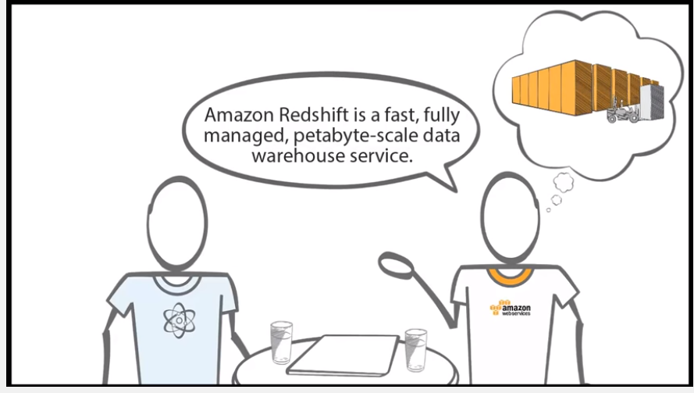

Slide 3
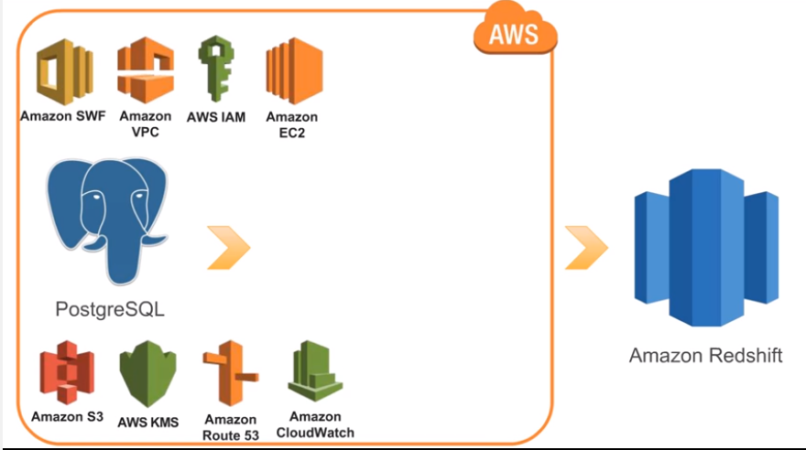

Slide 4
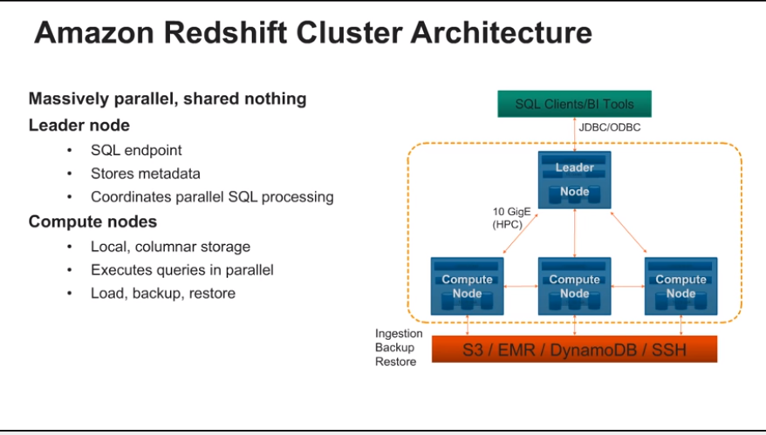

Slide 5
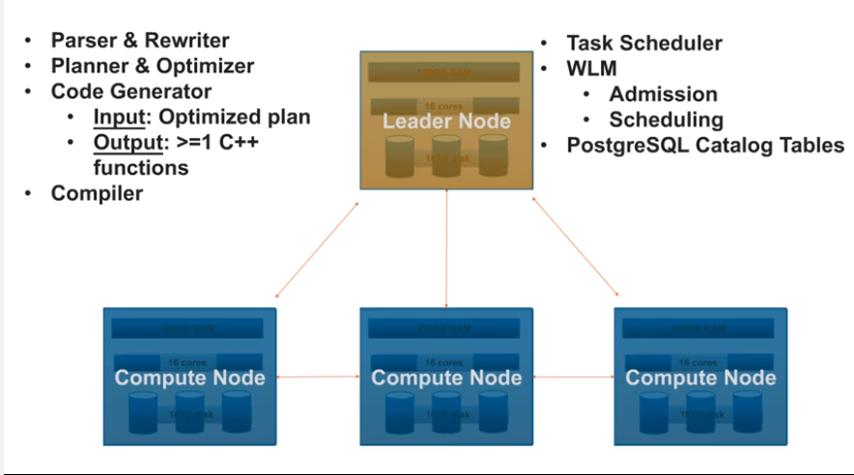

Slide 6
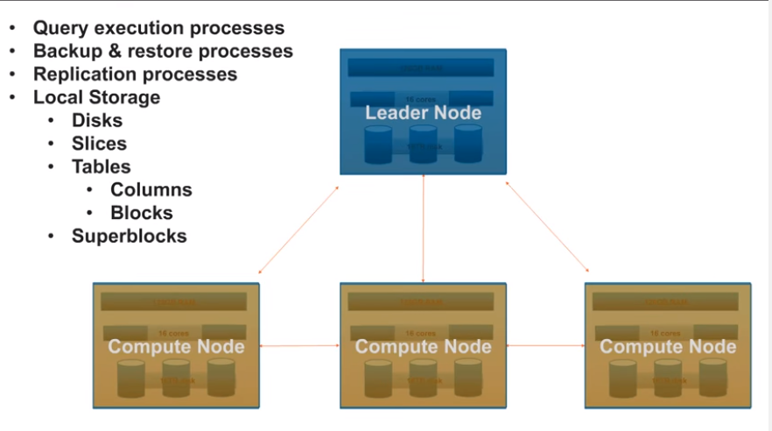

Slide 7
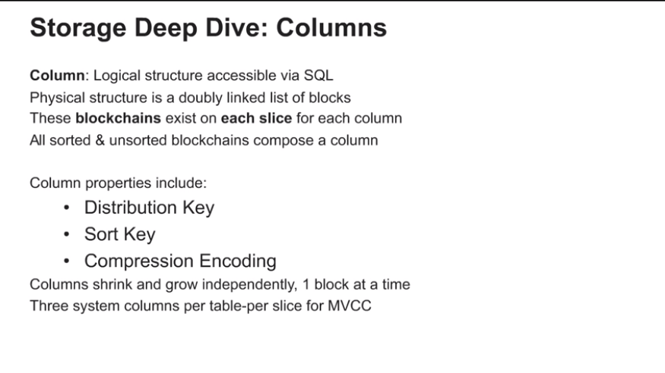

Slide 8
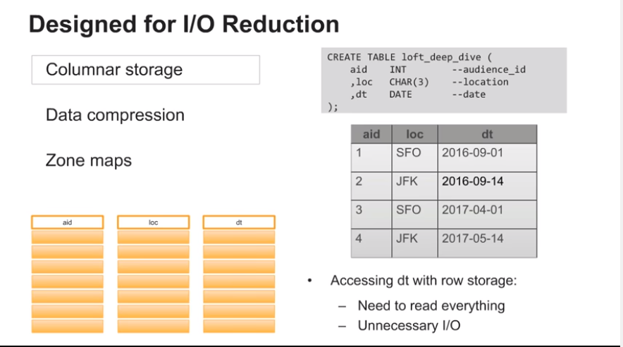

Slide 9
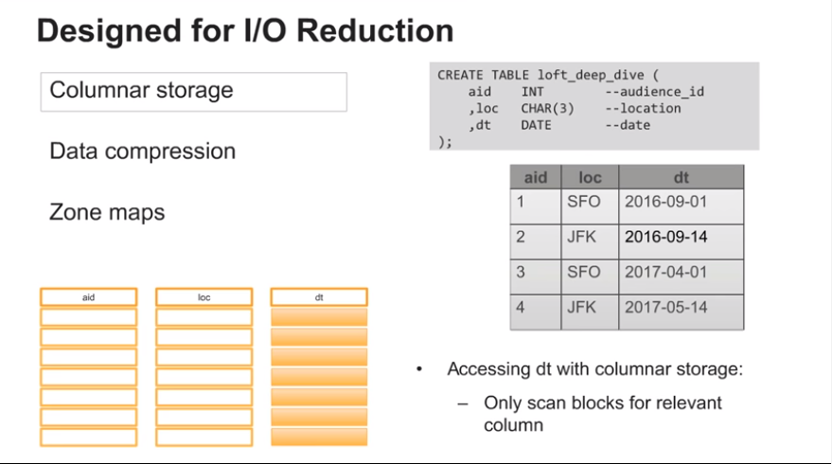

Slide 10
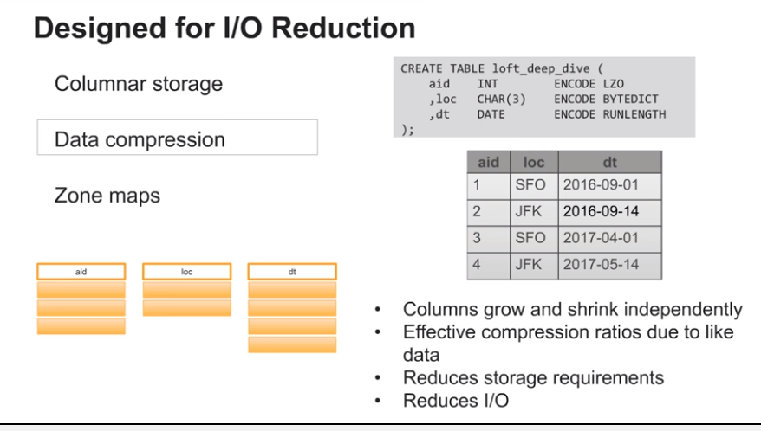

Slide 11
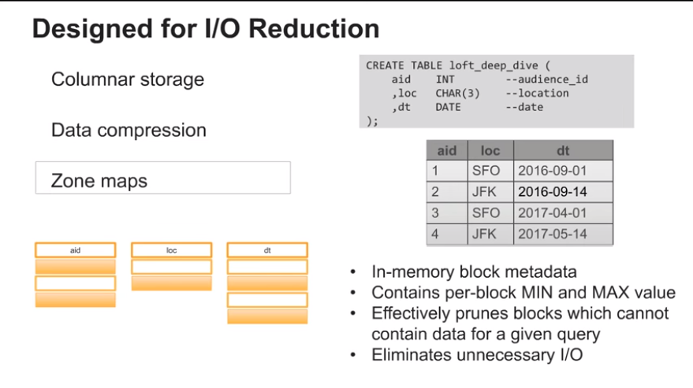

Slide 12
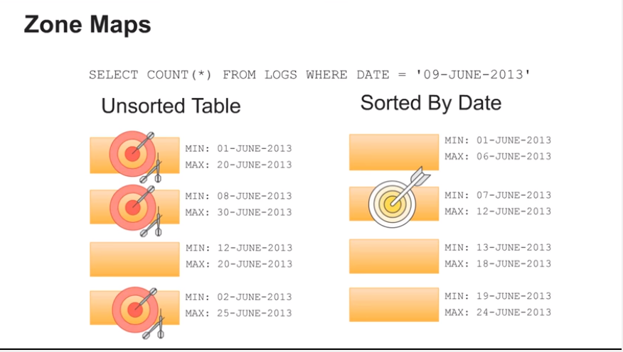

Slide 13
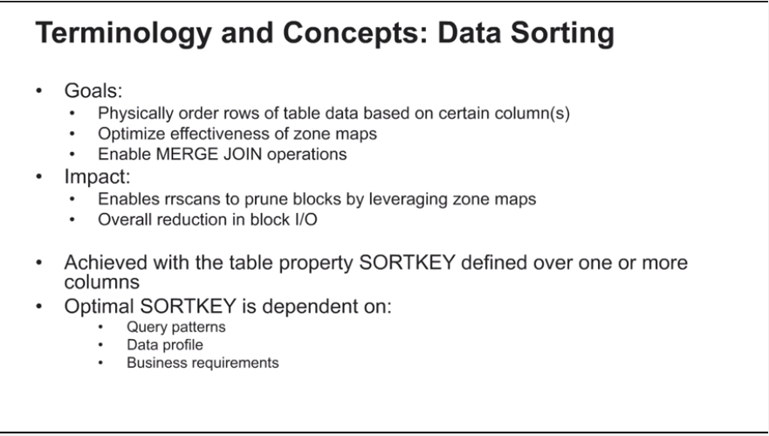

Slide 14
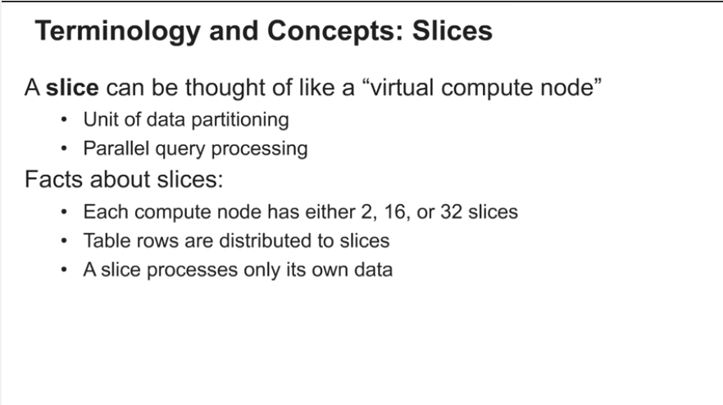

Slide 15
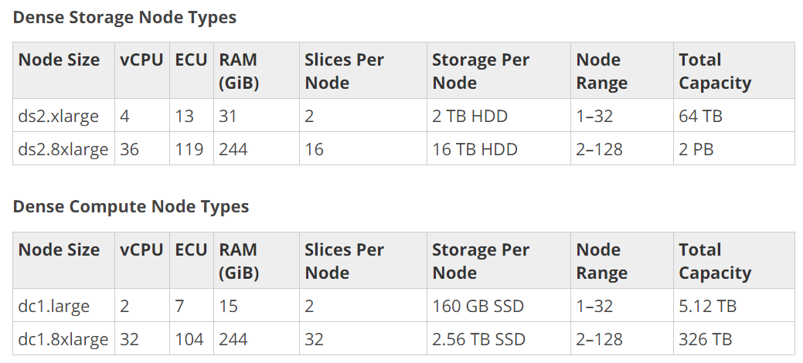

Slide 16
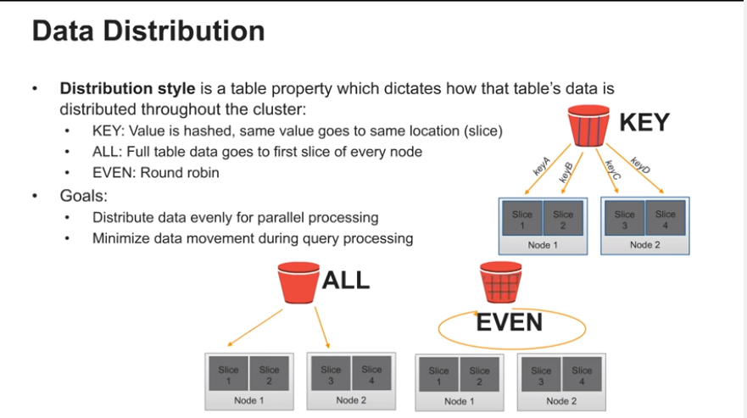

Slide 17
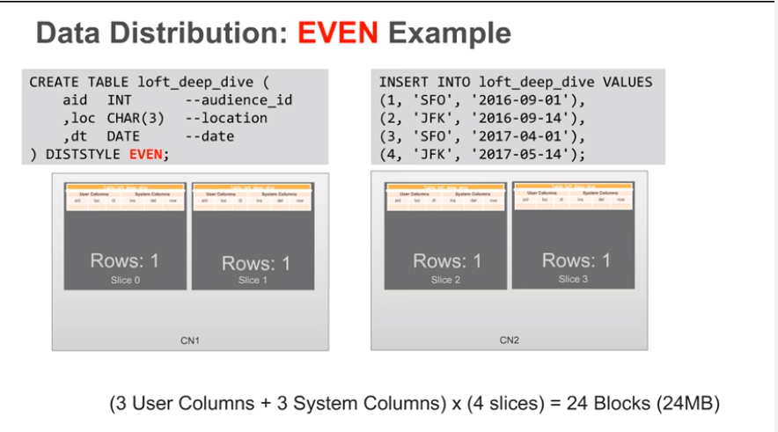

Slide 18
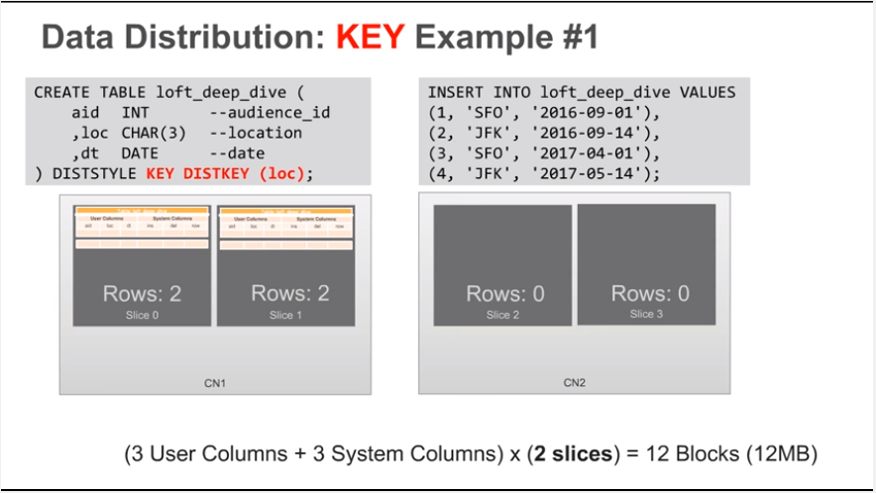

Slide 19
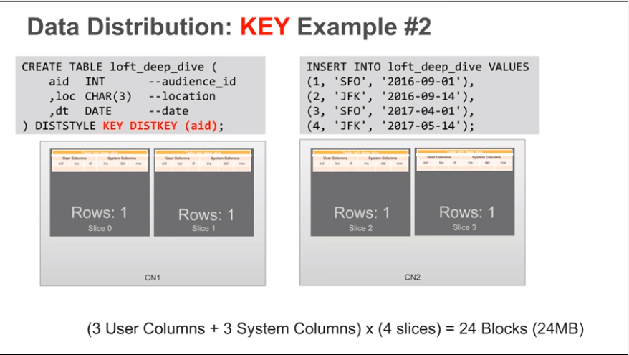

Slide 20
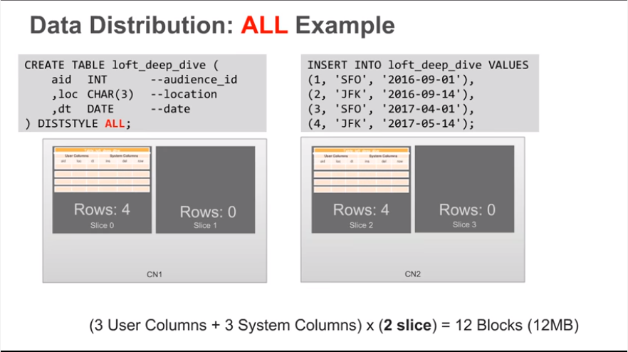

Slide 21
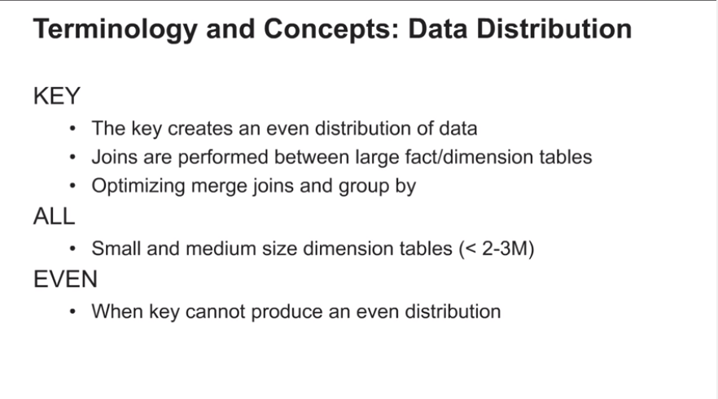

Slide 22


Slide 23
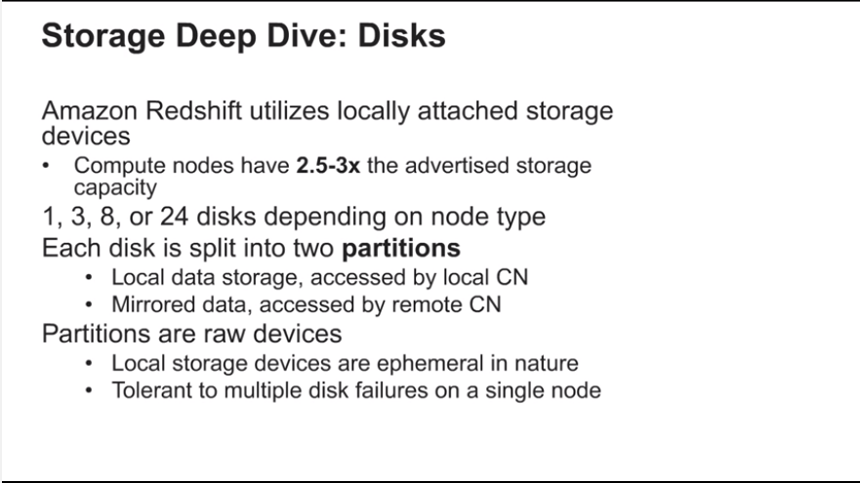

Slide 24
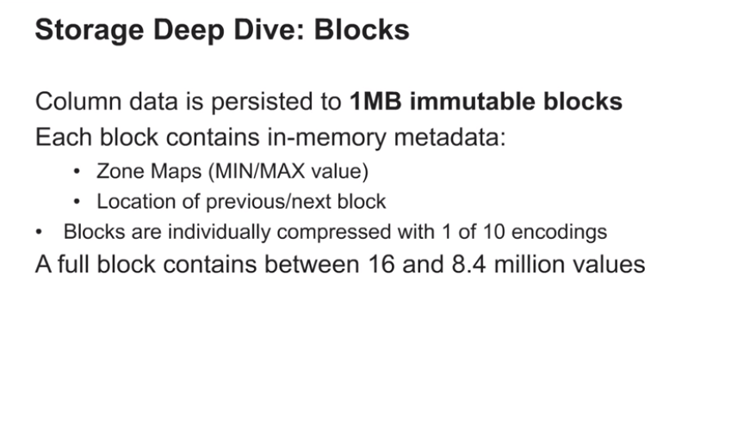

Slide 25
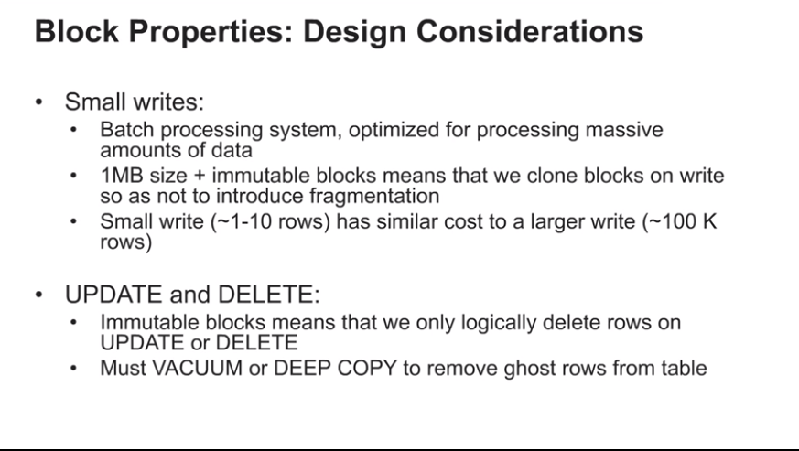

Slide 26
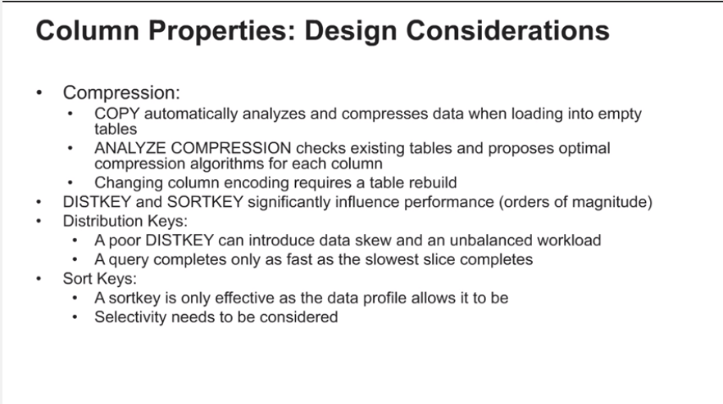

Slide 27


Slide 28
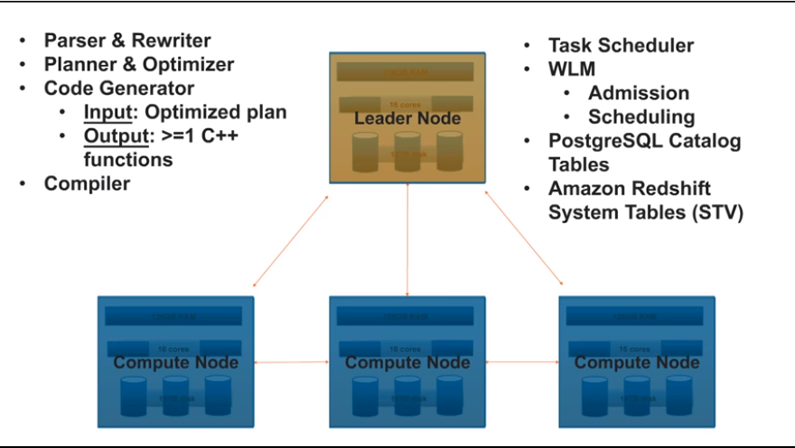

Slide 29
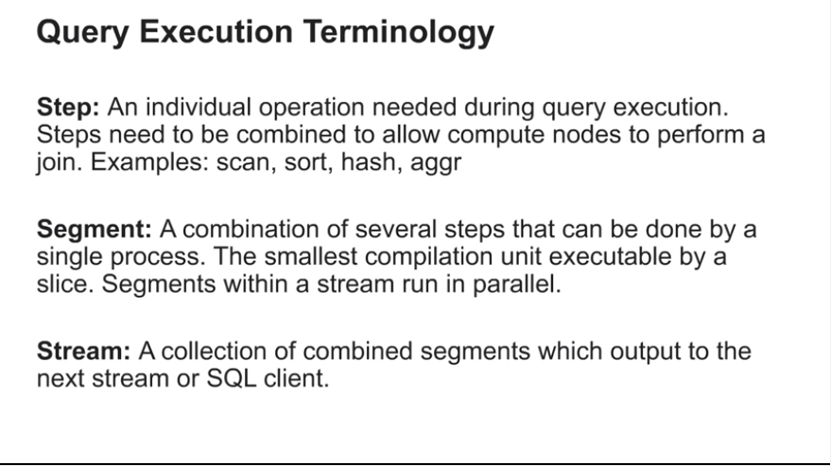

Slide 30
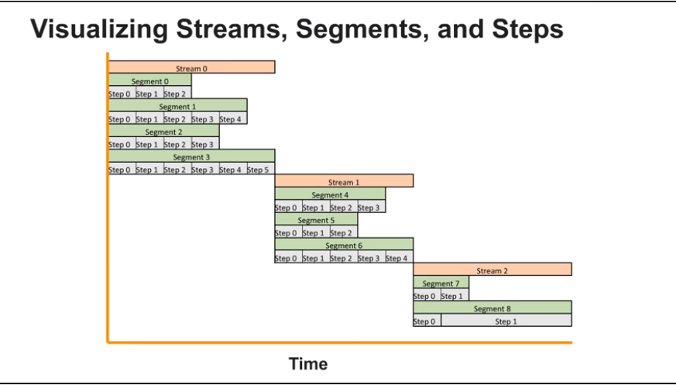

Slide 31
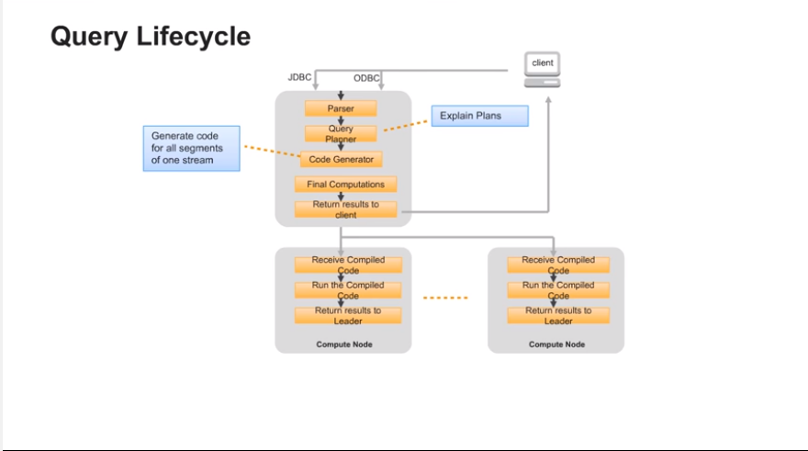

Slide 32
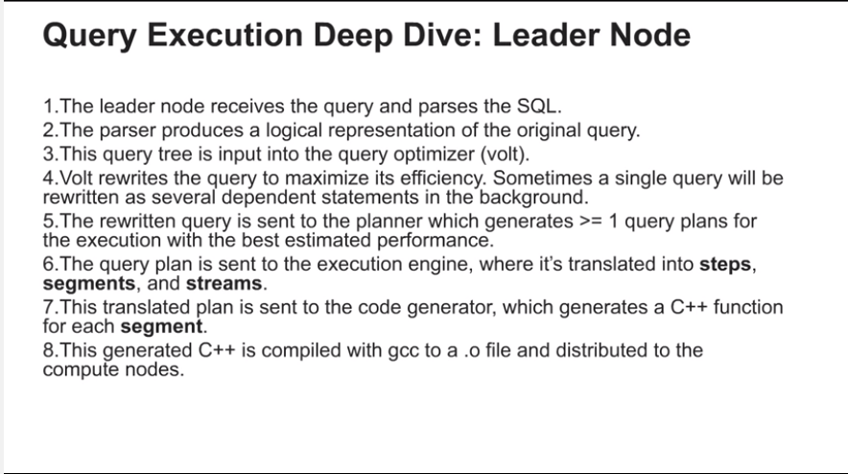

Slide 33
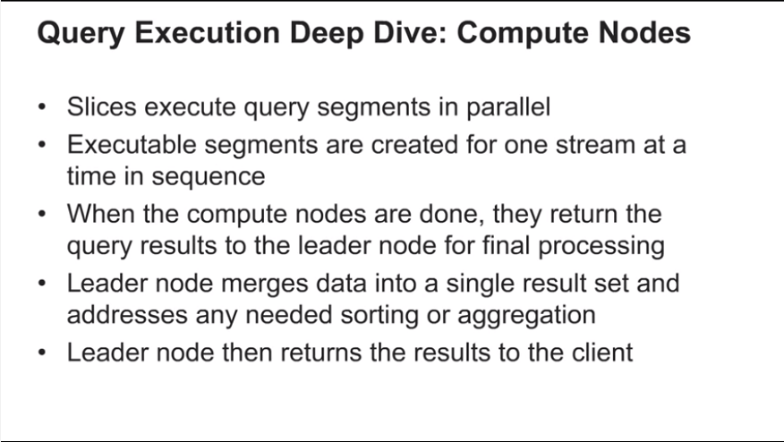

Slide 34
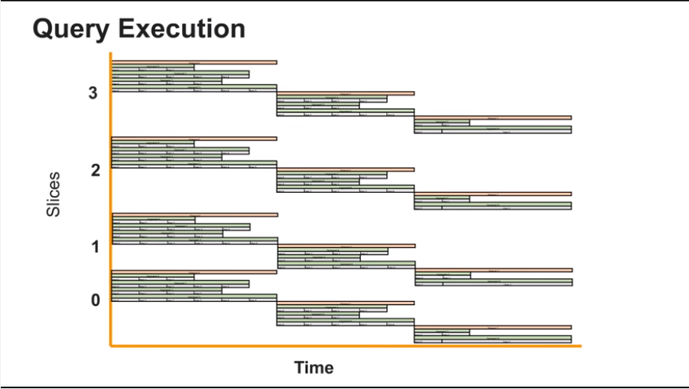

Slide 35
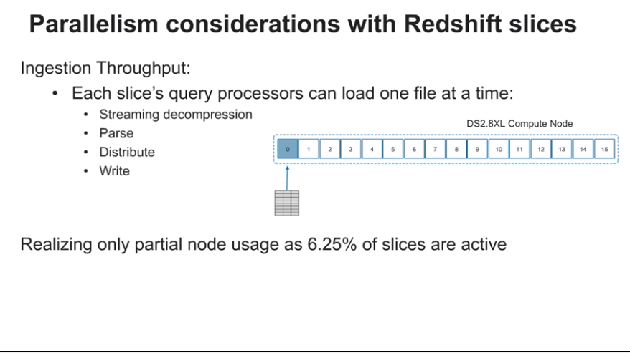

Slide 36
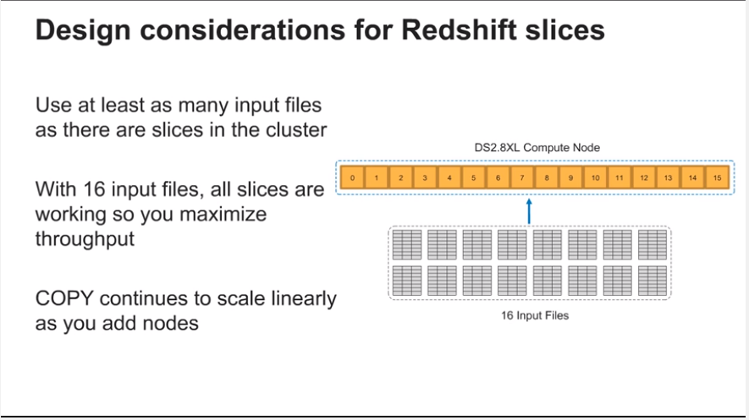

Slide 37
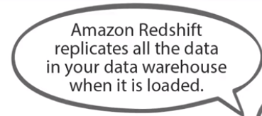
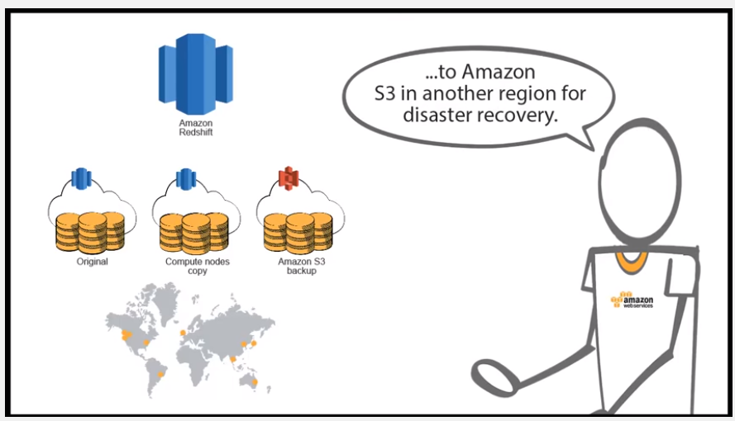






Slide 38
Amazon Redshift Spectrum
Amazon Redshift Spectrum enables you to run Amazon Redshift SQL queries against exabytes of data in Amazon S3. With Redshift Spectrum, you can extend the analytic power of Amazon Redshift beyond data stored on local disks in your data warehouse to query vast amounts of unstructured data in your Amazon S3 “data lake” -- without having to load or transform any data. Redshift Spectrum applies sophisticated query optimization, scaling processing across thousands of nodes so results are fast – even with large data sets and complex queries.
Redshift Spectrum directly queries data in Amazon S3 using the open data formats you already use, including CSV, TSV, Parquet, Sequence, and RCFile. Since Redshift Spectrum supports the same SQL syntax of Amazon Redshift, you can run sophisticated queries using the same Business Intelligence (BI) tools you use today. You can also run queries that span both the frequently accessed data stored locally in Amazon Redshift and your full data sets stored cost-effectively in Amazon S3.
Redshift Spectrum gives you the freedom to store your data where you want, in the format you want, and have it available for processing when you need it. There are no up-front payments or commitments with Redshift Spectrum; you only pay for the queries you run.

Slide 39
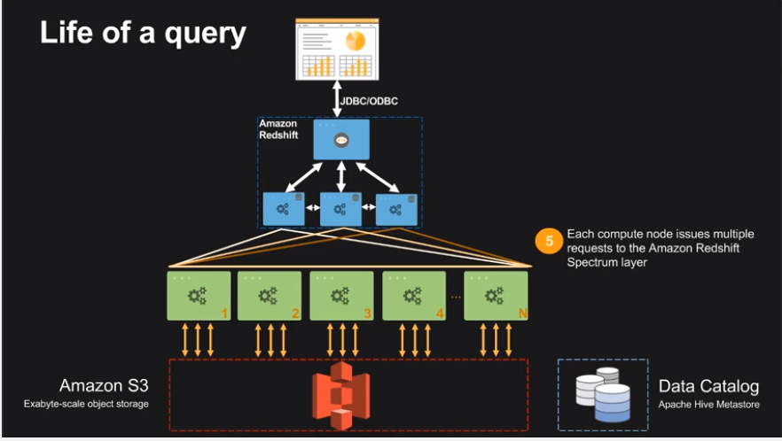

Slide 40
Useful Links
https://aws.amazon.com/blogs/big-data/top-10-performance-tuning-techniques-for-amazon-redshift/
https://www.youtube.com/watch?v=UhQjSzdlO_g
https://aws.amazon.com/redshift/faqs/
http://docs.aws.amazon.com/redshift/latest/dg/c_join_PG.html
http://docs.aws.amazon.com/redshift/latest/dg/r_VACUUM_command.html

Slide 41
Thank You

